Slide 1
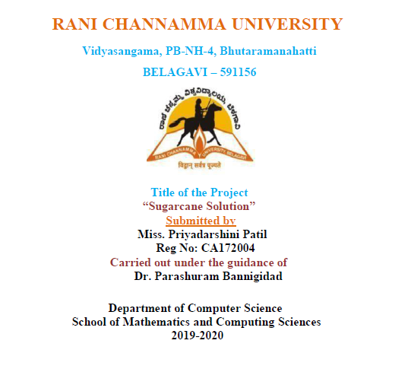

Slide 2
Contents
Introduction
Objective and Scope
Existing System
Disadvantages of Existing System
Proposed System
Advantages of Proposed System
Modules
Software Requirements
Hardware Requirements
System diagrams
Screen shots
Conclusion
Future Enhancement

Slide 3
INTRODUCTION
The net portal for farmer’s to increase sugarcane manufacturing utility is advanced to provide the facts about the sugarcane manufacturing and occasions to the farmers and college students. Era has grown so swiftly so in preference to journeying a couple of fields, that's time eating, farmers can visit online portal for their queries.
Farmer’s opt to see on-line portal wherein they could get many answers for their queries. They could visit the net portal 24/7.essentially, there are modules one is the admin module and other for the farmer.
The admin has the get entry to exchange or update something inside the utility like adding, deleting or enhancing of the activities and queries of farmers whereas the farmer has to sign in to the software and simplest then may be granted access to view and get answers from the utility.

Slide 4
Objective and Scope
To maximize the sugarcane production per unit of land, water and fertilizer use through various cane department programmers.
Development of improved cane varieties as per need of sugarcane growers and sugar mills and to development various technologies for sugarcane cultivation.
To carry out and promote trade of sugar and it’s by products.
To undertake market studies related to sugar and it’s by products.
Farmer can get all the information about the sugarcane farming and its related information.
Related contributors can reply to the questions asked by students.

Slide 5
Existing System
Within the current machine, farmers have to visit multiple agriculture workplace or fields to know the information about sugarcane manufacturing. it's miles hard to move and gather the facts from every other farmer or agriculture officer, on occasion they'll now not get the perfect solution as they wanted and its take long term. It can waste their entire day and some farmers can’t journey because shipping unavailability.
In conventional forming approach, one agriculture officer or farmer can’t show or provide all of the records about sugarcane production. All farmers can’t get the solution at time they have to wait in queue.

Slide 6
Disadvantages of Existing system
Low Yield of Sugarcane
Short crushing season
Low rate of recovery
High cost of Production
Too much competition in the market.

Slide 7
Proposed System
In the proposed app, this sugarcane app covers Cultivation Practices, Sustainable Sugarcane Initiative, Irrigation control, and Nutrient management for Sugarcane, Crop safety for Sugarcane, Farm Implements for Sugarcane.

Slide 8
Advantages of the proposed system
Instant Energy Booster.
Sugar has high demand.
Skin Care.
Bolster Immunity.
Stronger Bone.

Slide 9
Modules
Admin Module:
Admin should be able to login in web application and assign chat session to Professor.
Admin should be able to add/update/delete the events.
Admin post events.
Users Module:
Role: Farmer, Professor, Students.
Professor should be able to login and reply to questions asked by farmer in text format.
Farmer Response to the questions.
Farmer/Professor should be able to end the chat session.
Professor/Students should get details of future/past event details
Farmer has to be able to get the data about sugarcane farming.
Student should Registration and login into the system.

Slide 10
Hardware Requirements
Processor : Pentium 4 or Above
RAM : 4GB or Above
Storage Capacity : 500GB free space in hard disk

Slide 11
Software Requirements
Operating System : Windows 10
Web Server : XAMPP Server
IDE : Microsoft Visual Code
Web Browser : Google Chrome, Internet Explorer etc.
Database : My SQL
Designing Tools : HTML, CSS, Bootstraps.
Programming languages : Angular JS, Node.js.
Back End : MySQL.
Framework : Cakephp Framework, Ionic Framework,

Slide 12
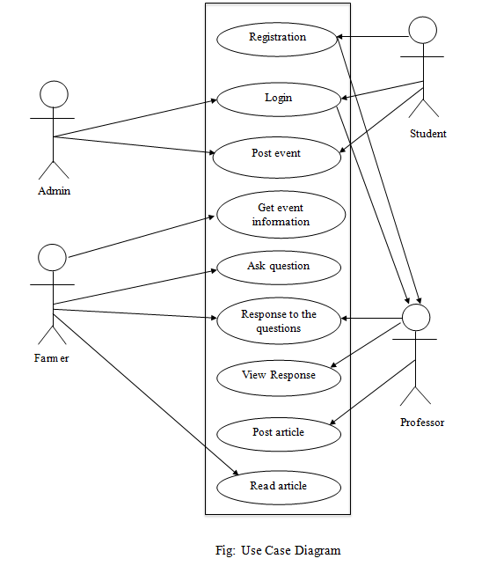
Use Case Diagram

Slide 13
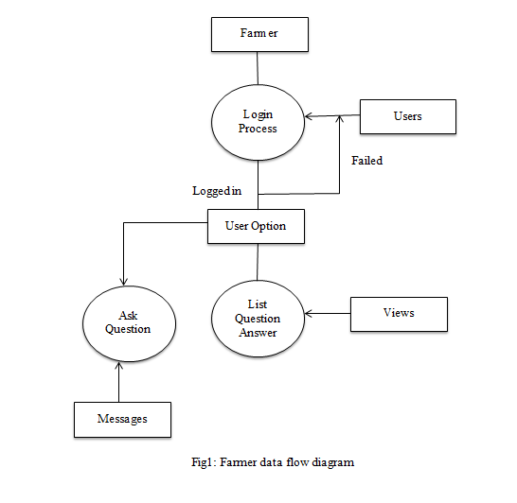
Farmer data flow diagram

Slide 14
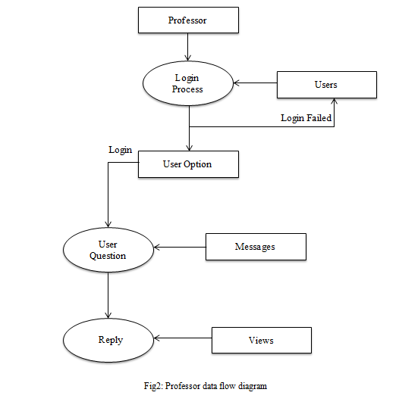
Professor data flow diagram:

Slide 15
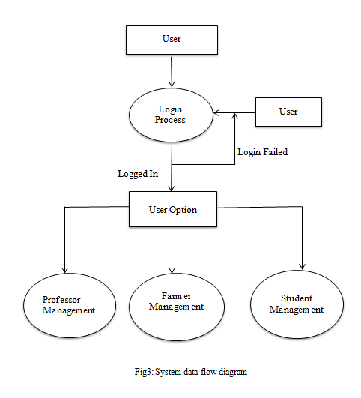
System data flow diagram

Slide 16
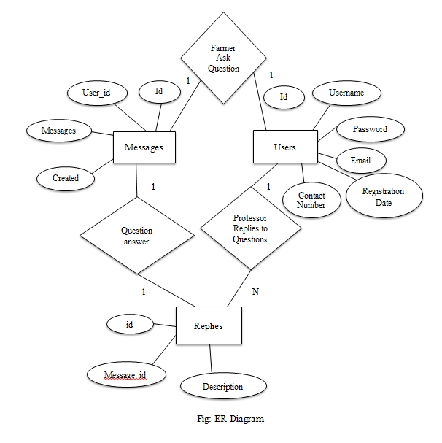
ER-Diagram

Slide 17
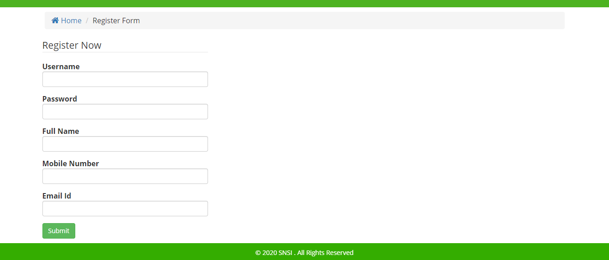
Screenshots:
Register Page

Slide 18
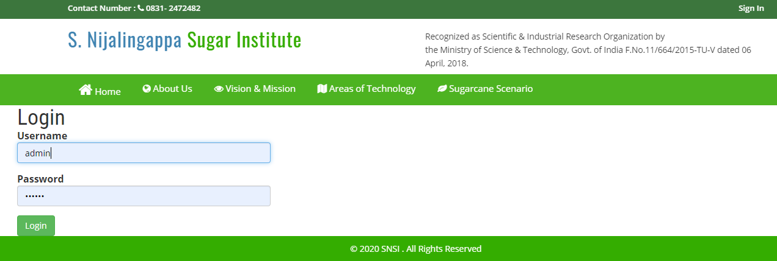
Login Page

Slide 19
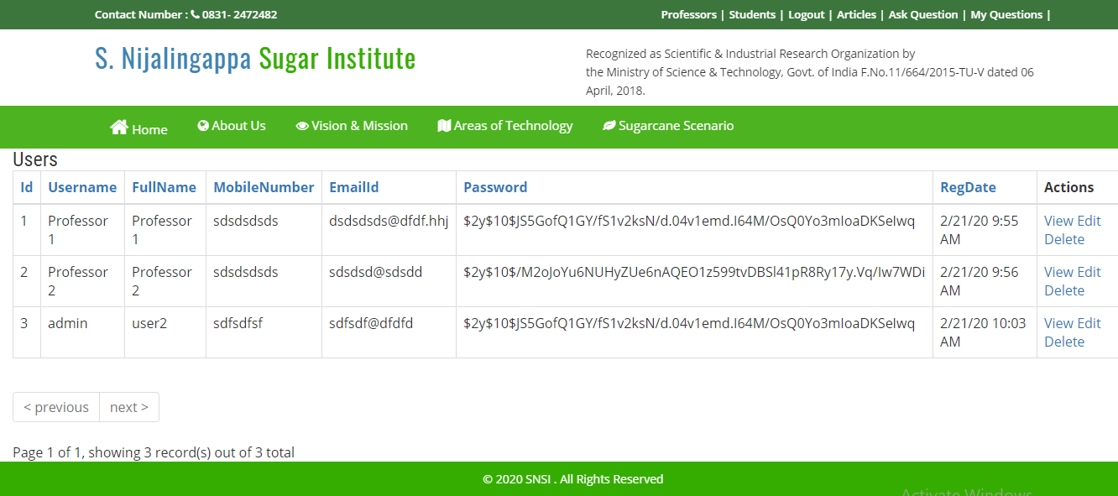
Professors Page

Slide 20
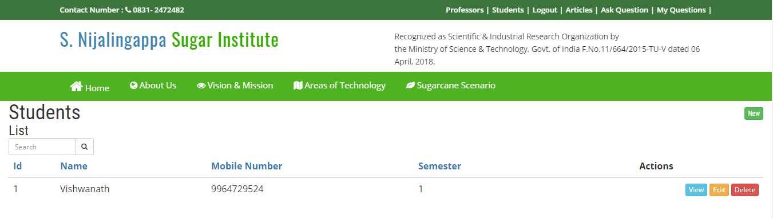
Students List Page

Slide 21
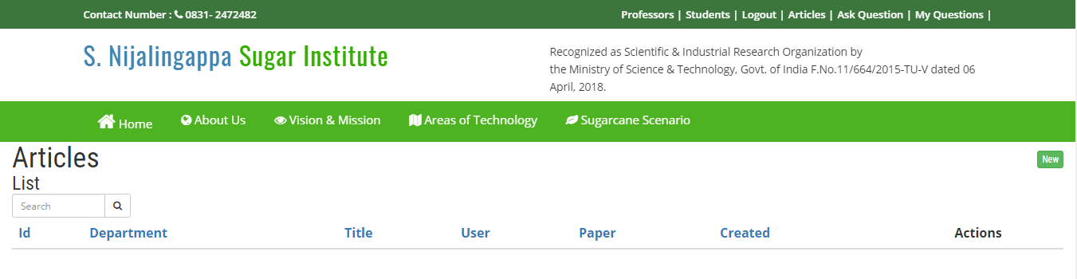
List of Articles Page

Slide 22
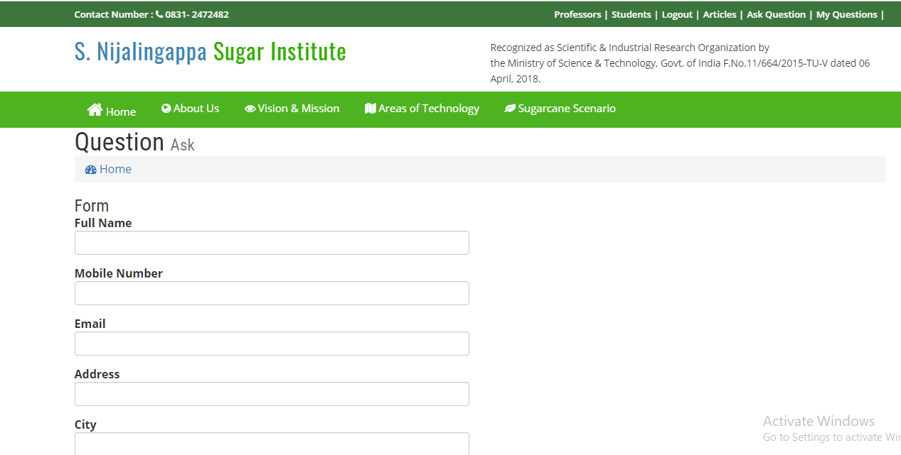
Question Ask Page

Slide 23
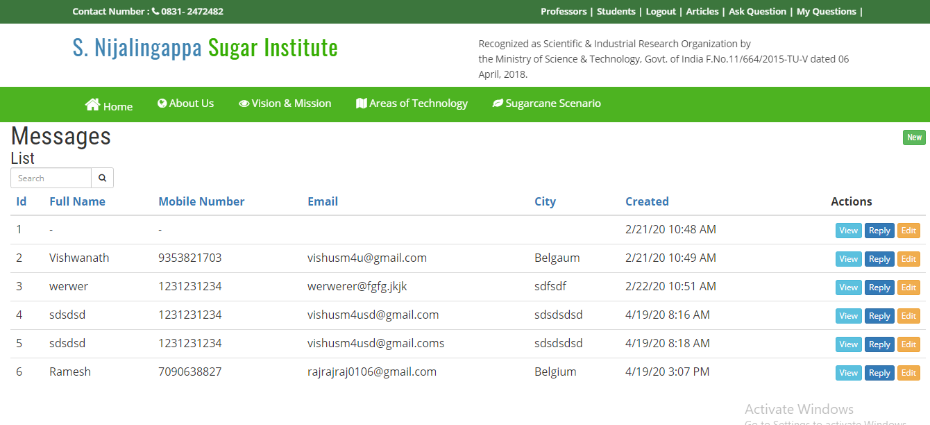
My Questions Page

Slide 24
Conclusion
This utility also saves the time of the farmer by means of making the whole lot smooth i.e. farmer can got each and the whole thing records approximately sugarcane production.

Slide 25
Future Enhancement
The "SNSI" is a web application for online entrance for farmers. Innovation has grown with the goal that Sugarcane farmers can get the arrangement through the online procedure. Despite the fact that they can get each arrangement identified with their individual sugarcane land.
We will make site more informative for the user .
User friendly.
We will attempt to make this technique easier and useful for the customers.

